Slide 1
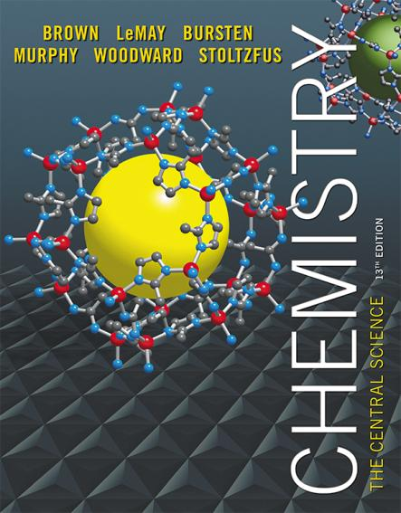
Lecture Presentation
Chapter 10 Gases

Slide 2
Characteristics of Gases
Physical properties of gases are all similar.
Composed mainly of nonmetallic elements with simple formulas and low molar masses.
Unlike liquids and solids, gases
expand to fill their containers.
are highly compressible.
have extremely low densities.
Two or more gases form a homogeneous mixture.

Slide 3
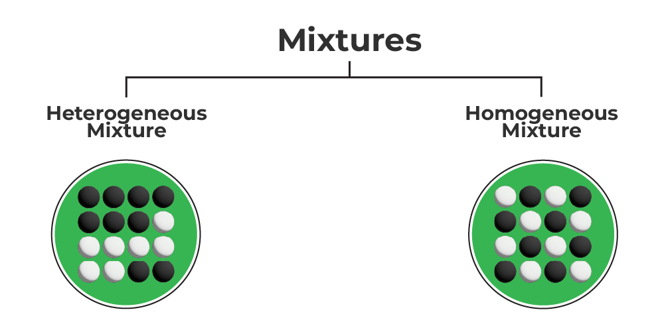

Slide 4
Properties Which Define the State of a Gas Sample
Temperature
Pressure
Volume
Amount of gas, usually expressed as number of moles
Having already discussed three of these, we need to define pressure.

Slide 5
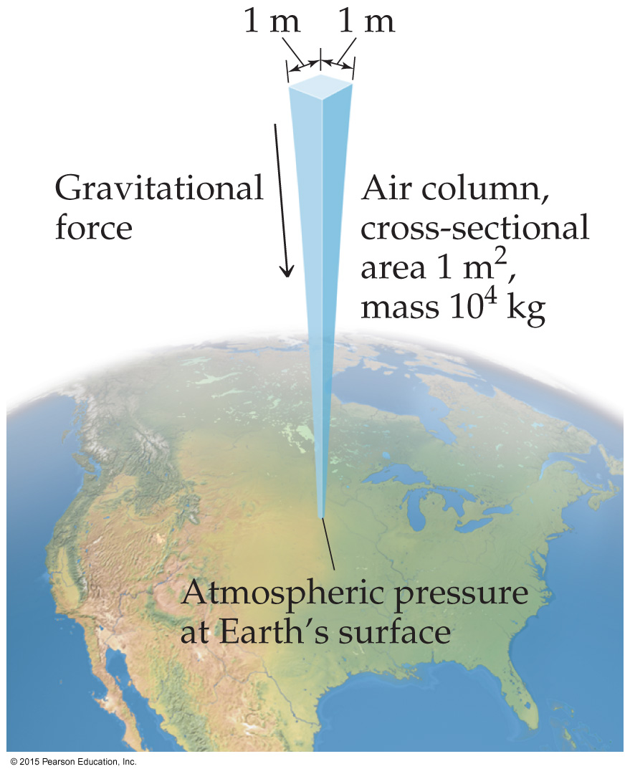
Pressure
Pressure is the amount of force applied to an area:
F
A
P =
Atmospheric pressure is the weight of air per unit of area.

Slide 6
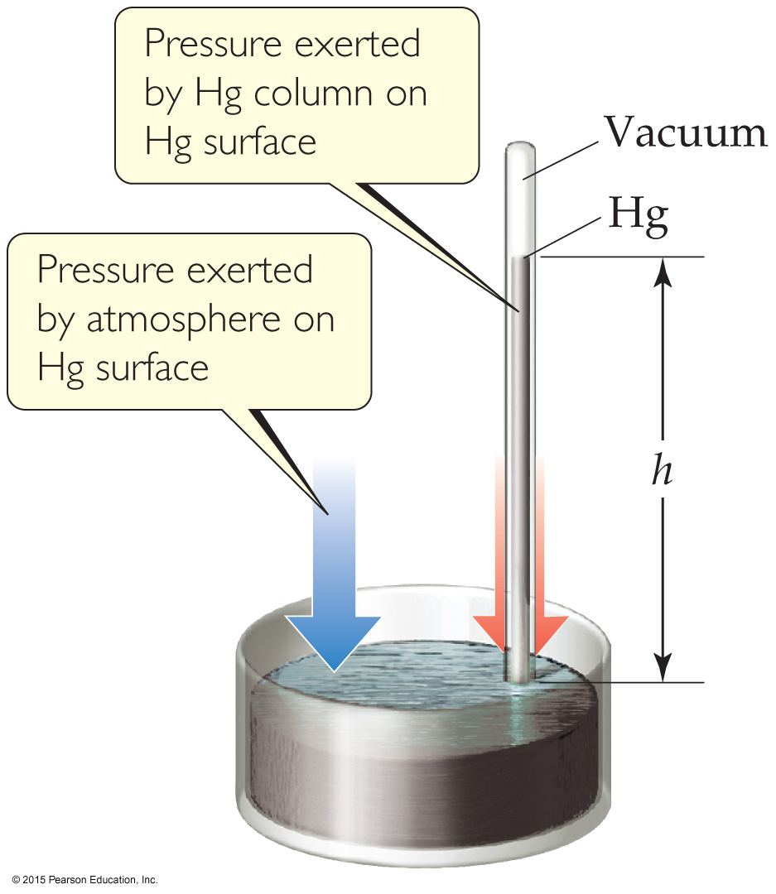
Units of Pressure
Pascals: 1 Pa = 1 N/m² (SI unit of pressure)
Bar: 1 bar = 10⁵ Pa = 100 kPa
mm Hg or torr: These units are literally the difference in the heights measured in mm of two connected columns of mercury, as in the barometer in the figure.
Atmosphere:
1.00 atm = 760 torr = 760 mm Hg = 101.325 kPa

Slide 7
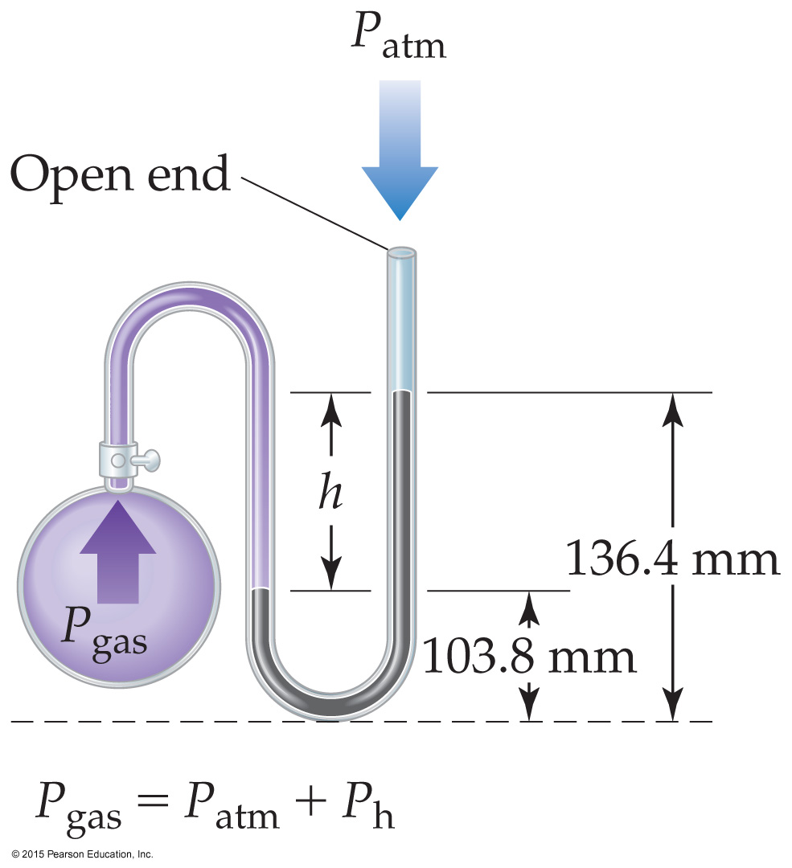
Manometer
The manometer is used to measure the difference in pressure between atmospheric pressure and that of a gas in a vessel. (The barometer seen on the last slide is used to measure the pressure in the atmosphere at any given time.)

Slide 8
Standard Pressure
Normal atmospheric pressure at sea level is referred to as standard atmospheric pressure.
It is equal to
1.00 atm.
760 torr (760 mmHg).
101.325 kPa.

Slide 9
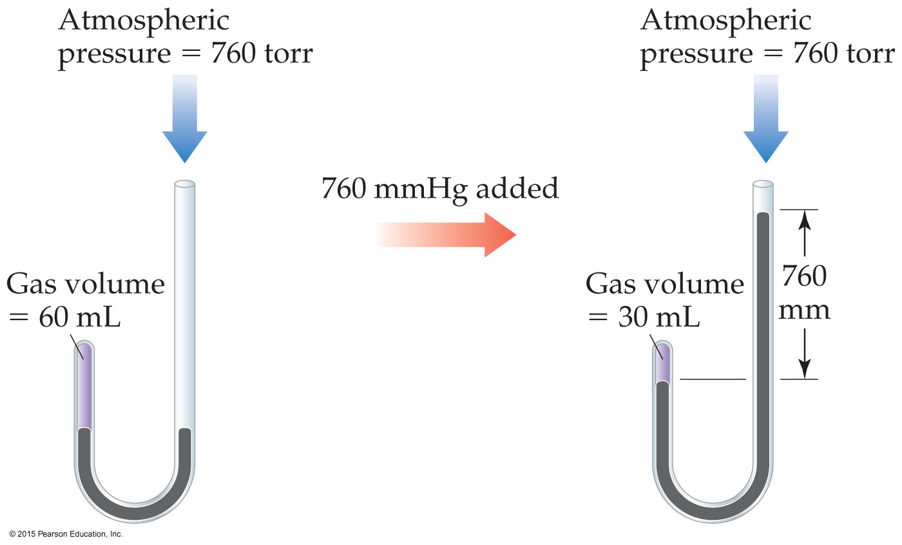
Boyle’s Law
The volume of a fixed quantity of gas at constant temperature is inversely proportional to the pressure.

Slide 10
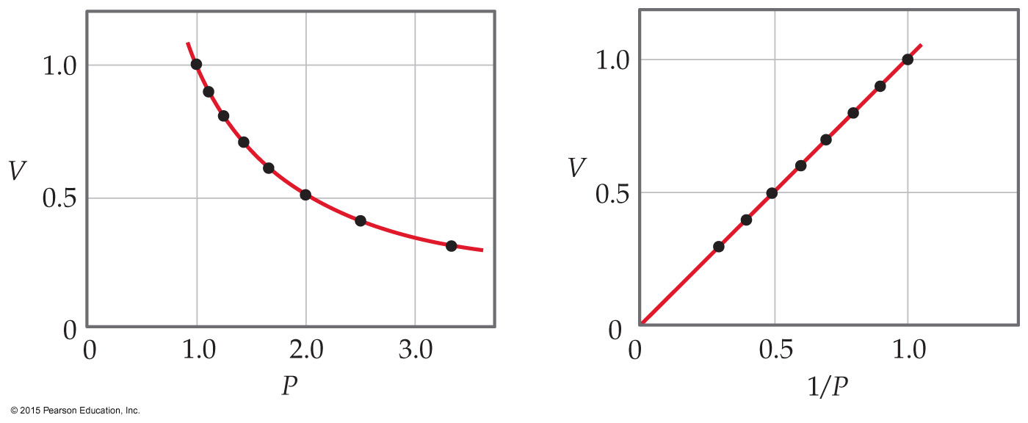
Mathematical Relationships of Boyle’s Law
PV = a constant
This means, if we compare two conditions: P₁V₁ = P₂V₂.
Also, if we make a graph of V vs. P, it will not be linear. However, a graph of V vs. 1/P (reciprocal of P) will result in a linear relationship!
Notes:
reciprocal

Slide 11
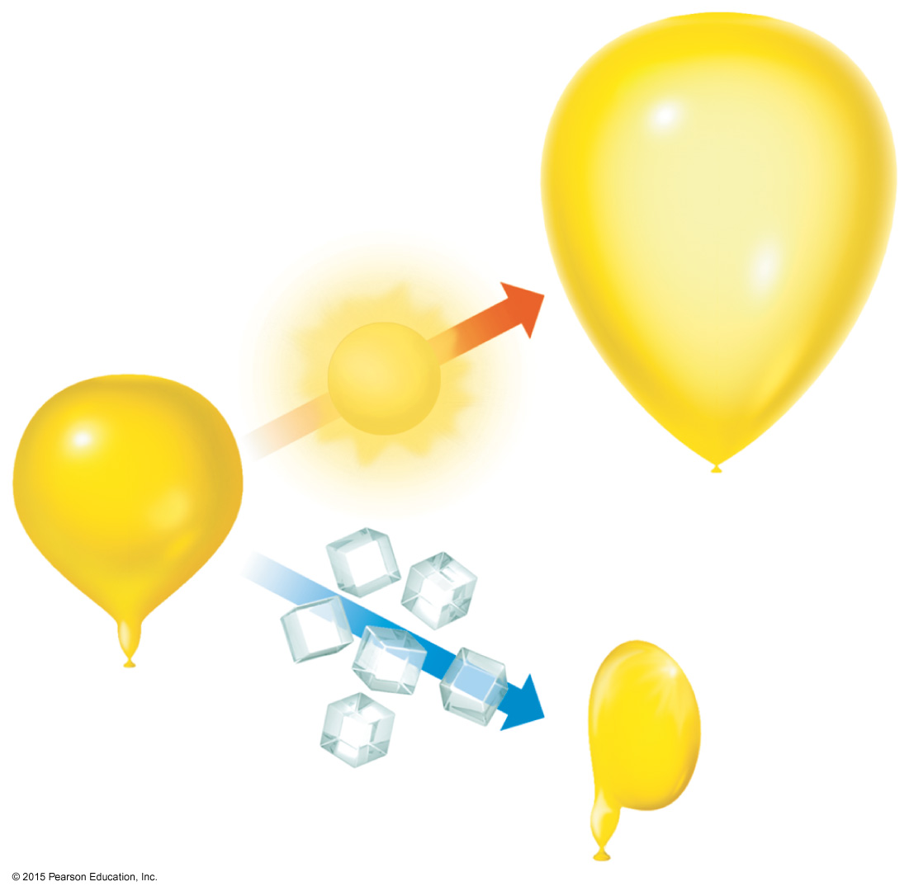
Charles’s Law
The volume of a fixed amount of gas at constant pressure is directly proportional to its absolute temperature.

Slide 12
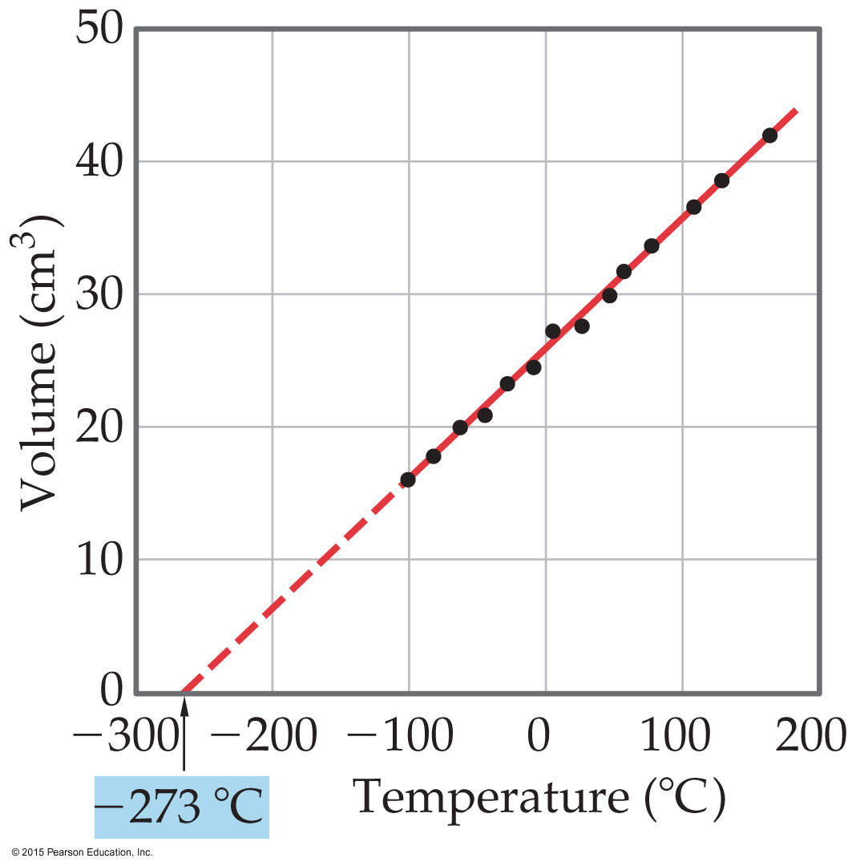
Mathematical Relationships of Charles’s Law
V = constant × T
This means, if we compare two conditions: V₁/T₁ = V₂/T₂.
Also, if we make a graph of V vs. T, it will be linear.

Slide 13
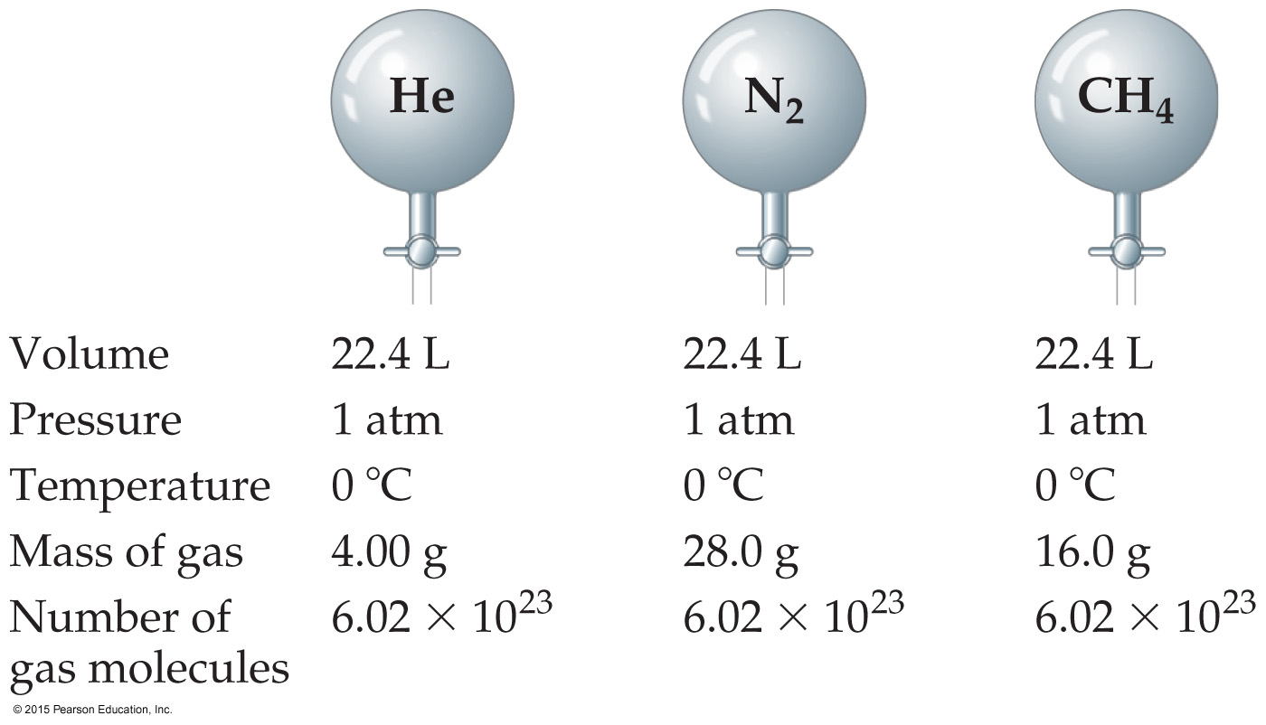
Avogadro’s Law
The volume of a gas at constant temperature and pressure is directly proportional to the number of moles of the gas.
Also, at STP, one mole of gas occupies 22.4 L.
Mathematically: V = constant × n, or V₁/n₁ = V₂/n₂

Slide 14
Ideal-Gas Equation
So far we’ve seen that
V ∝ 1/P (Boyle’s law).
V ∝ T (Charles’s law).
V ∝ n (Avogadro’s law).
Combining these, we get
nT
P
V ∝
Finally, to make it an equality, we use a constant of proportionality (R) and reorganize; this gives the Ideal-Gas Equation: PV = nRT.

Slide 15
Density of Gases
If we divide both sides of the ideal-gas equation by V and by RT, we get
n/V = P/RT.
Also: moles × molecular mass = mass
n × M = m.
If we multiply both sides by M, we get
m/V = MP/RT
and m/V is density, d; the result is:
d = MP/RT.

Slide 16
Density & Molar Mass of a Gas
To recap:
One needs to know only the molecular mass, the pressure, and the temperature to calculate the density of a gas.
d = MP/RT
Also, if we know the mass, volume, and temperature of a gas, we can find its molar mass.
M = mRT/PV

Slide 17
Volume and Chemical Reactions
The balanced equation tells us relative amounts of moles in a reaction, whether the compared materials are products or reactants.
PV = nRT
So, we can relate volume for gases, as well.
For example: use (PV = nRT) for substance A to get moles A; use the mole ratio from the balanced equation to get moles B; and (PV = nRT) for substance B to get volume of B.

Slide 18
Dalton’s Law of Partial Pressures
If two gases that don’t react are combined in a container, they act as if they are alone in the container.
The total pressure of a mixture of gases equals the sum of the pressures that each would exert if it were present alone.
In other words,
P_{total} = p₁ + p₂ + p₃ + …

Slide 19
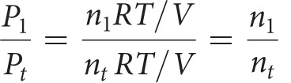

Mole Fraction
Because each gas in a mixture acts as if it is alone, we can relate amount in a mixture to partial pressures:
That ratio of moles of a substance to total moles is called the mole fraction, χ.

Slide 20
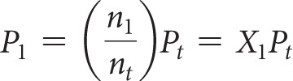
Pressure and Mole Fraction
The end result is

Slide 21
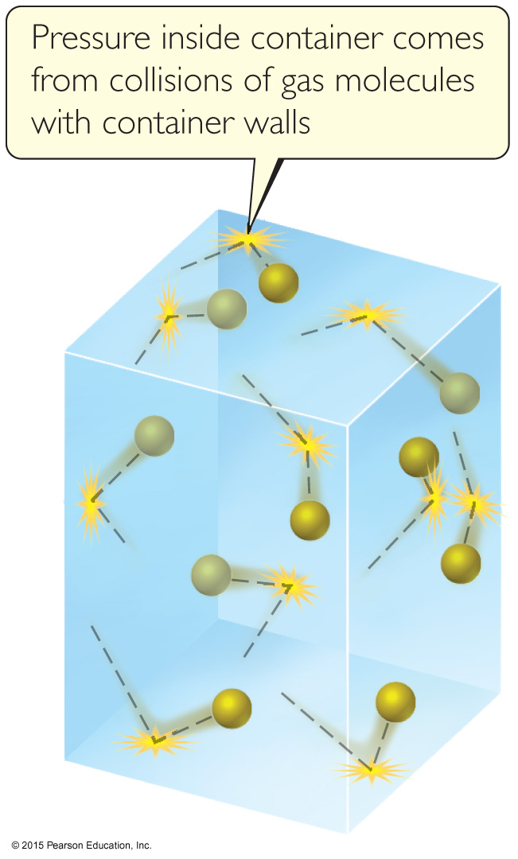
Kinetic-Molecular Theory
Laws tell us what happens in nature. Each of the gas laws we have discussed tell us what is observed under certain conditions.
Why are these laws observed? We will discuss a theory to explain our observations.

Slide 22
Main Tenets of Kinetic-Molecular Theory
Gases consist of large numbers of molecules that are in continuous, random motion.
The combined volume of all the molecules of the gas is negligible relative to the total volume in which the gas is contained.
Attractive and repulsive forces between gas molecules are negligible.

Slide 23
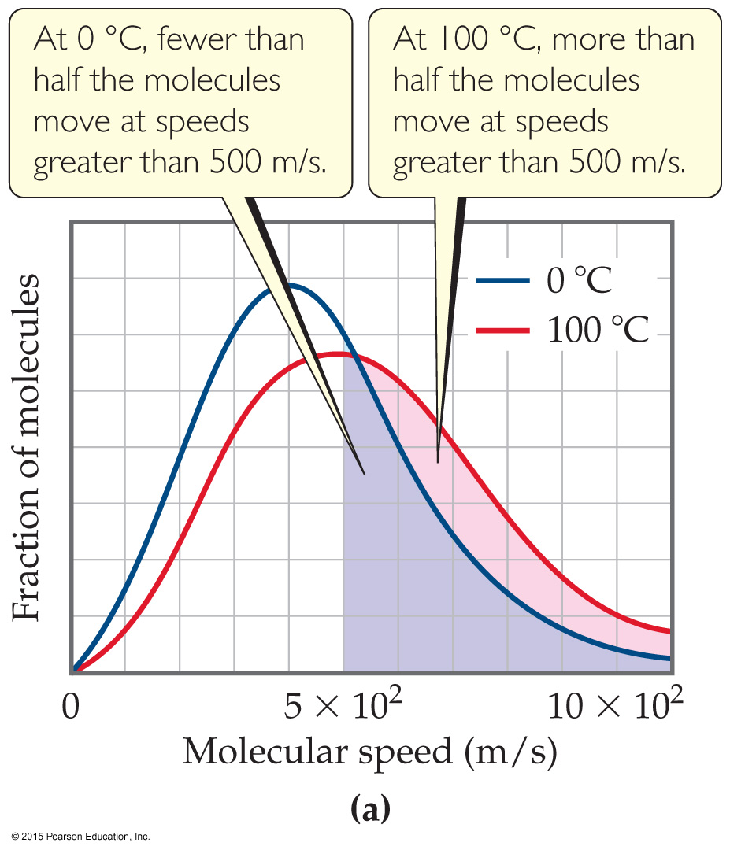
Main Tenets of Kinetic-Molecular Theory
Energy can be transferred between molecules during collisions, but the average kinetic energy of the molecules does not change with time, as long as the temperature of the gas remains constant.
The average kinetic energy of the molecules is proportional to the absolute temperature.

Slide 24
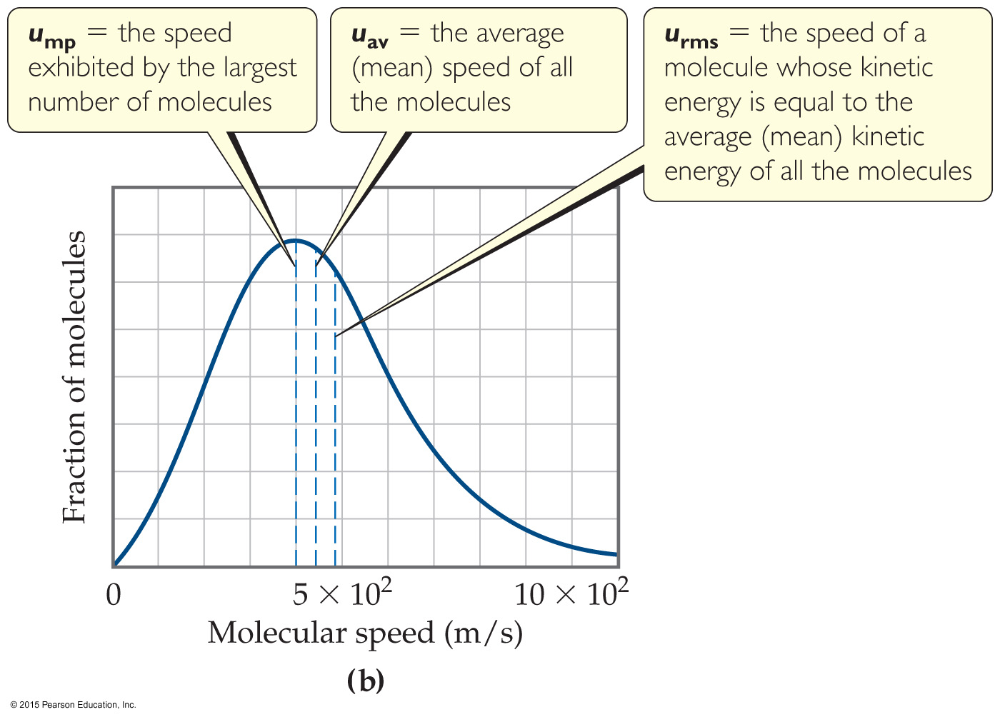
How Fast Do Gas Molecules Move?
Temperature is related to their average kinetic.
Individual molecules can have different speeds of motion.
The figure shows three different speeds:
u_{mp} is the most probable speed (most molecules are this fast).
u_{av} is the average speed of the molecules.
u_{rms}, the root-mean-square speed, is the one associated with their average kinetic energy.

Slide 25
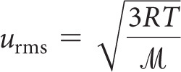
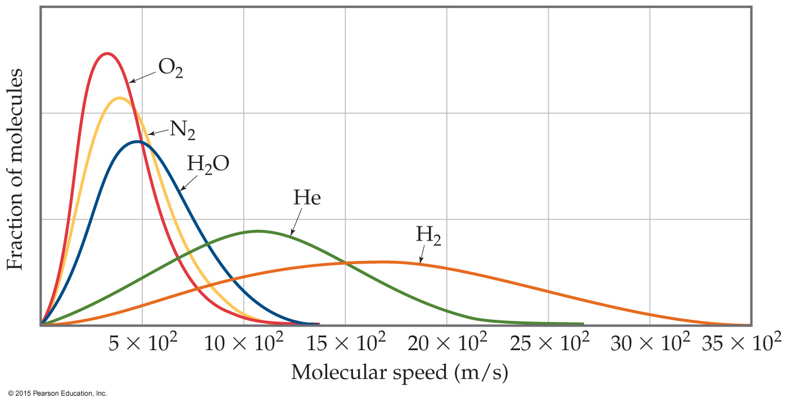
u_{rms} and Molecular Mass
At any given temperature, the average kinetic energy of molecules is the same.
So, ½ m (u_{rms})² is the same for two gases at the same temperature.
If a gas has a low mass, its speed will be greater than for a heavier molecule.

Slide 26
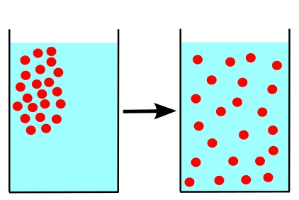
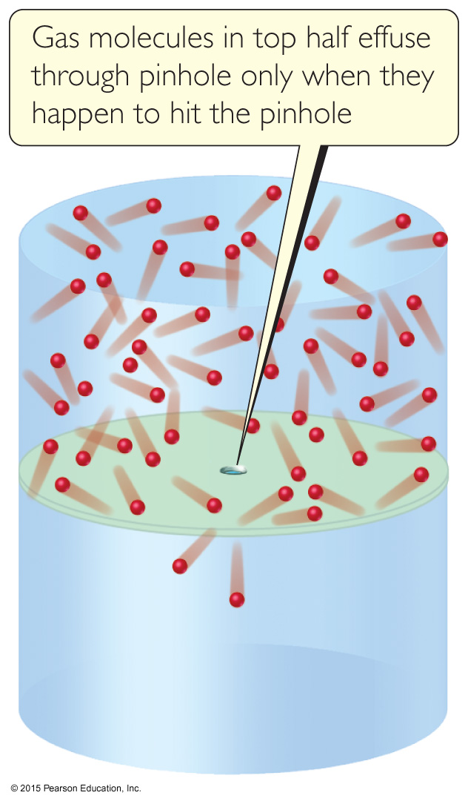
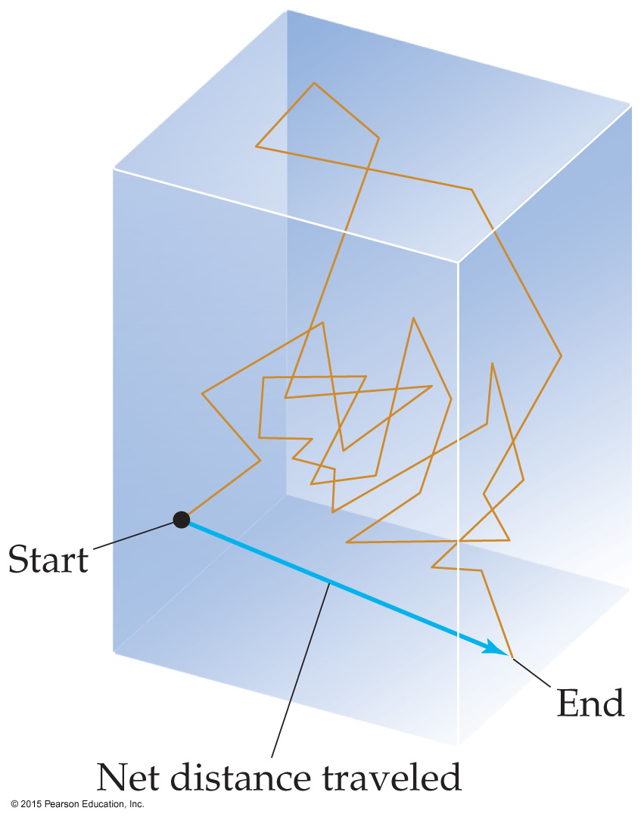
Effusion & Diffusion
Effusion（渗透）is the escape of gas molecules through a tiny hole into an evacuated space.
Diffusion（扩散）is the spread of one substance throughout a space or a second substance.

Slide 27
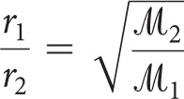
Graham’s Law Describes Diffusion & Effusion
Graham’s Law relates the molar mass of two gases to their rate of speed of travel.
The “lighter” gas always has a faster rate of speed.
rate
Molar mass

Slide 28
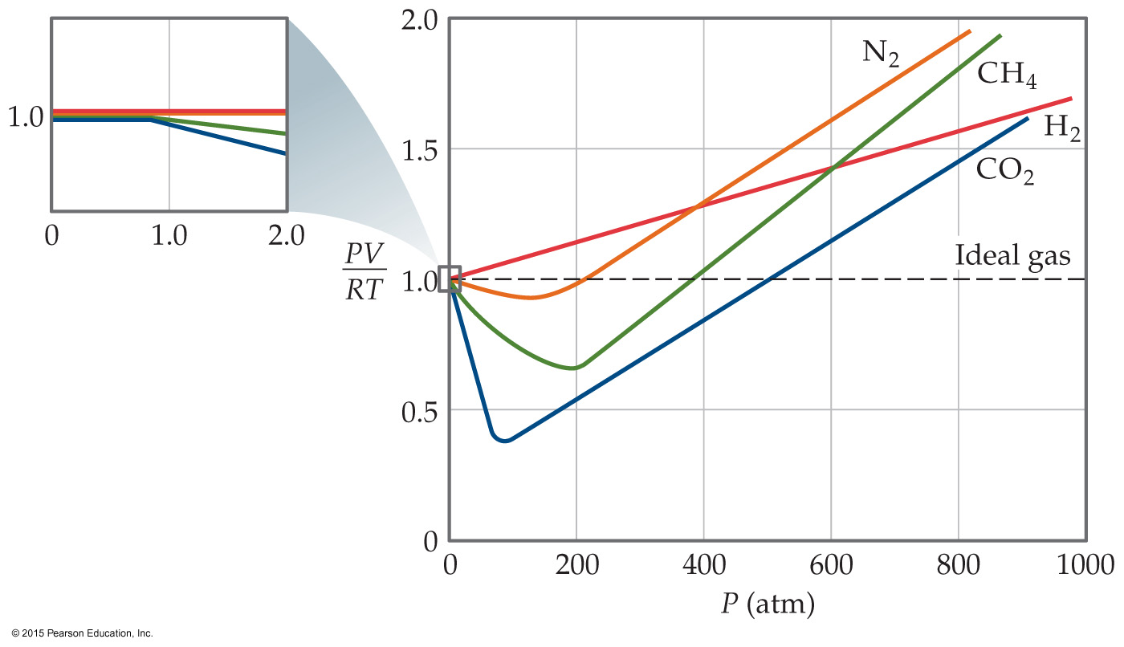
Real Gases
In the real world, the behavior of gases only conforms to the ideal-gas equation at relatively high temperature and low pressure.
Even the same gas will show wildly different behavior under high pressure at different temperatures.

Slide 29
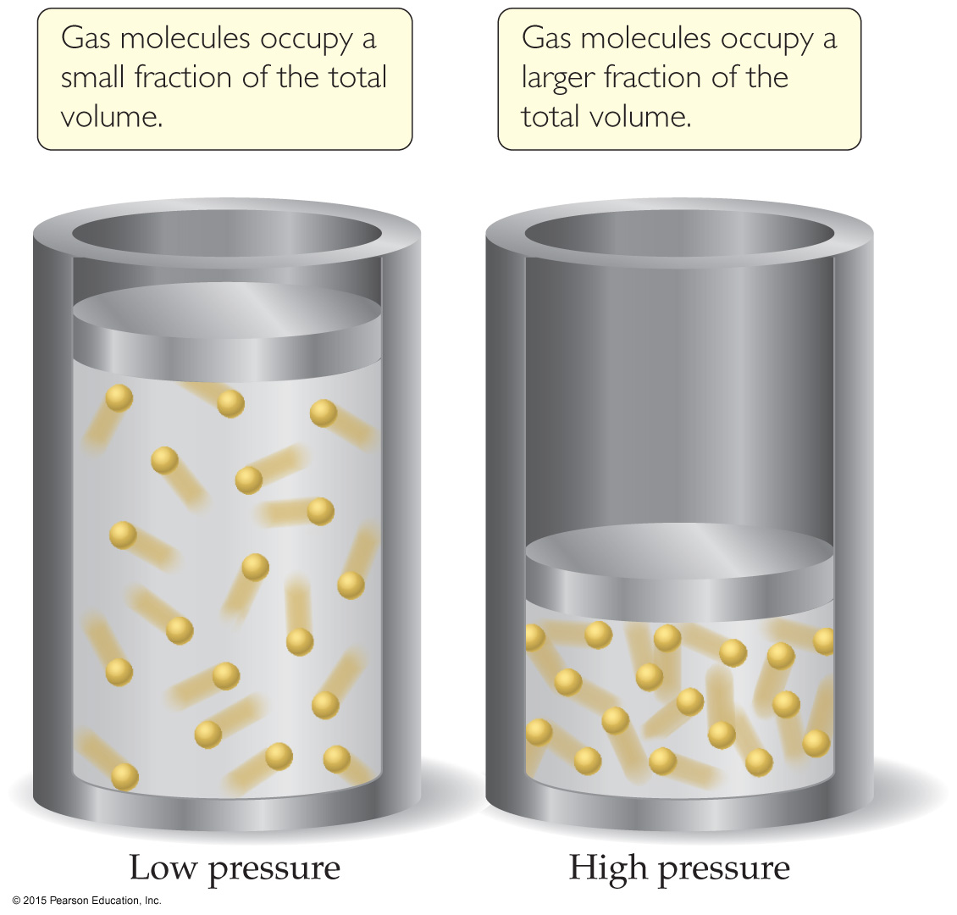
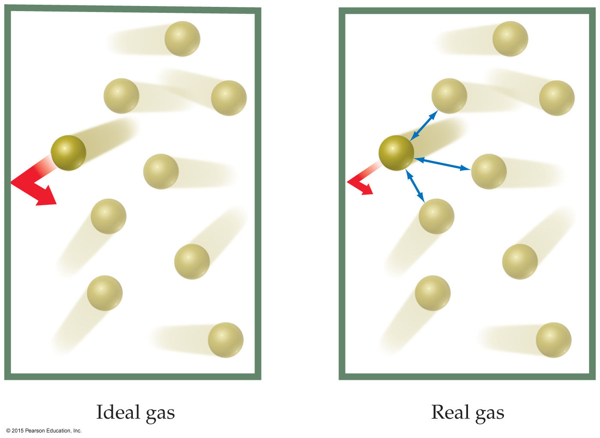
Deviations from Ideal Behavior
The assumptions made in the kinetic-molecular model (negligible volume of gas molecules themselves, no attractive forces between gas molecules, etc.) break down at high pressure and/or low temperature.

Slide 30
Corrections for Nonideal Behavior
The ideal-gas equation can be adjusted to take these deviations from ideal behavior into account.
The corrected ideal-gas equation is known as the van der Waals equation.
The pressure adjustment is due to the fact that molecules attract and repel each other.
The volume adjustment is due to the fact that molecules occupy some space on their own.

Slide 31
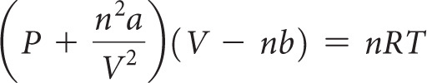
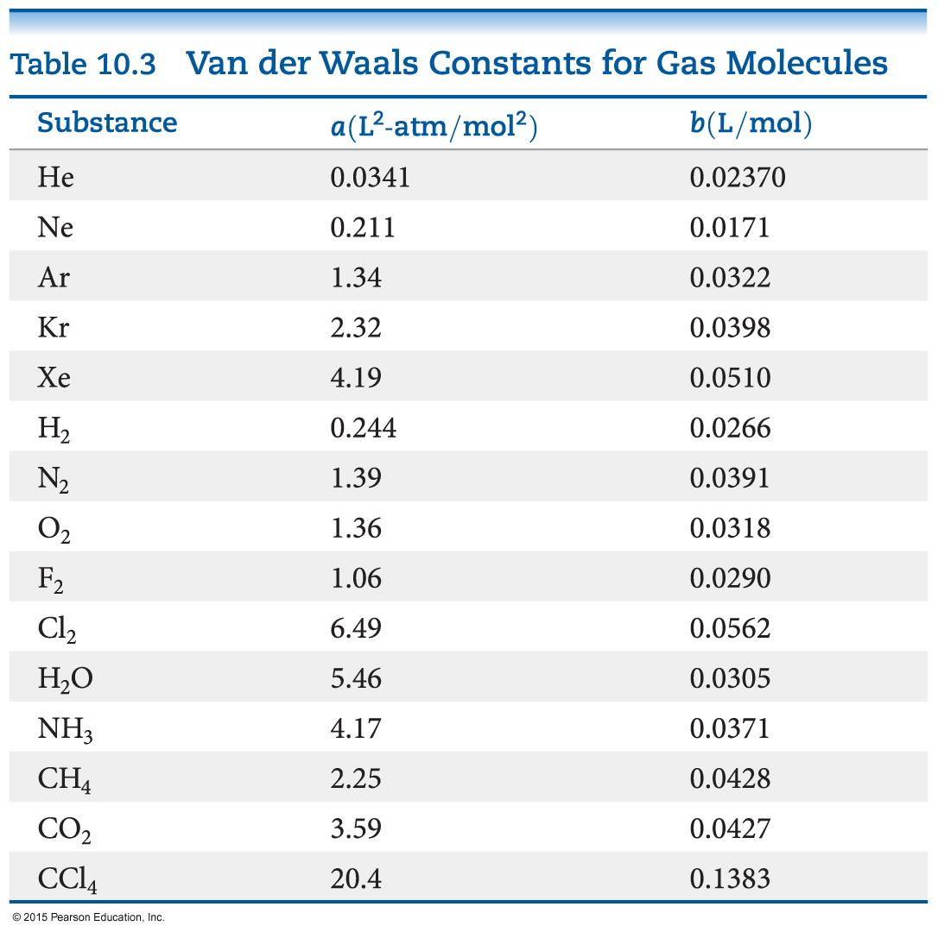
The van der Waals Equation

